Slide 1
STUDENT NAME:HARIHARAN E.P.
REGISTER NO AND NMID:212403706,6436@velsrscollege.com
DEPARTMENT:BCA
COLLEGE: COLLEGE/ UNIVERSITY:Vel Tech ranga sanku arts college Madras University

Slide 2
PROJECT TITLE: BREW BLISS COFFEE SHOP WEBSITE

Slide 3


AGENDA
Problem Statement
Project Overview
End Users
Tools and Technologies
Portfolio design and Layout
Features and Functionality
Results and Screenshots
Conclusion
Github Link
3/21/2024 Annual Review

Slide 4

Problem statement Traditional coffee shops struggle with limited online visibility, lack of convenient ordering, and minimal customer engagement beyond the store. Brew Bliss Coffee Shop relies mainly on in-person interactions, making it harder to reach wider audiences, update menus, and manage customer preferences. To address this, a web-based platform is needed to showcase offerings, streamline orders and feedback, and improve overall customer satisfaction and business growth.

Slide 5

PROJECT OVERVIEW The Brew Bliss Coffee Shop Website is an online platform that allows customers to browse menus, place orders, and share feedback, while providing admins with tools to manage offerings, orders, and reports. It enhances customer engagement, streamlines operations, and strengthens the café’s online presence.

Slide 6

WHO ARE THE END USERS? Customers – People who visit the website to browse the menu, place orders, give feedback, and engage with the café online. Administrators (Cafe Owners/Staff) – Individuals who manage the website, update menus, view reports, handle feedback, and oversee customer interactions.

Slide 7

TOOLS AND TECHNIQUES HTML, CSS, JavaScript MySQL (database) PowerPoint (presentation)

Slide 8
POTFOLIO DESIGN AND LAYOUT
Homepage: Welcomes users with branding, navigation bar, and featured sections like signature brews and offers.
Customer Login Page: Secure portal for customers to sign in and access the menu, place orders, and provide feedback.
Admin Login Page: Dedicated login for administrators to access the dashboard.
Admin Dashboard: Central hub for managing menu items, orders, reports, feedback, and system settings.
Menu Page: Displays available coffee and food items with descriptions, images, and pricing.
About Page: Provides details about the café, story, and values with styled animations.
Feedback Section: Enables customers to submit reviews and suggestions, visible in the admin panel.
8

Slide 9
FEATURES AND FUNCTIONALITY Administrator Features Admin Login – Secure access to the admin panel. Dashboard – Overview of orders, menu, reports, and customer activity. Menu Management – Add, update, or remove menu items easily. Order Management – Track and manage customer orders efficiently. Feedback Management – View and respond to customer reviews..

Slide 10
FEATURES AND FUNCTIONALITY Customer Features User Login/Signup – Secure portal for customers to access personalized services. Browse Menu – View coffee and food items with images, descriptions, and prices. Place Orders – Convenient online ordering system. Feedback System – Submit reviews and suggestions directly through the website. Responsive Design – Accessible on desktop, tablet, and mobile devices.

Slide 11
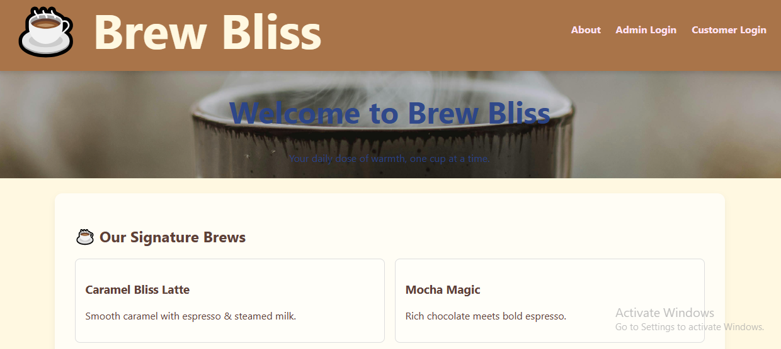
RESULT AND SCREENSHOTS

Slide 12
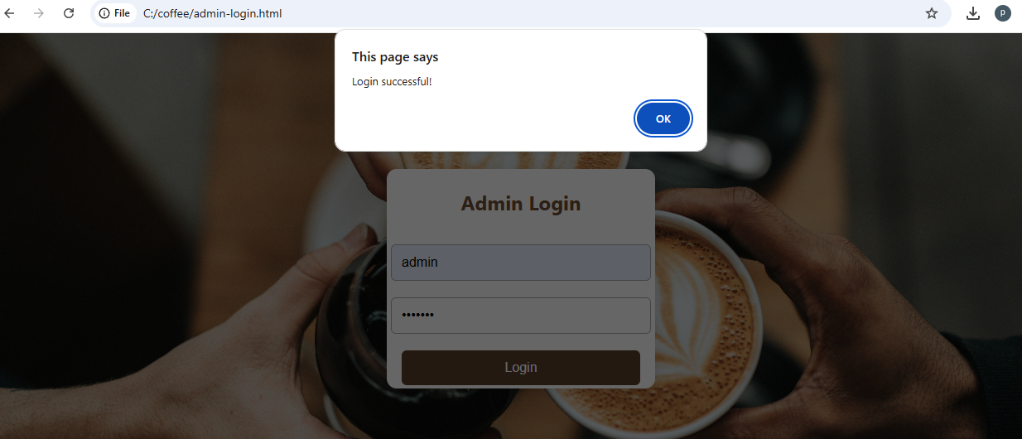
A
ADMIN LOGIN

Slide 13
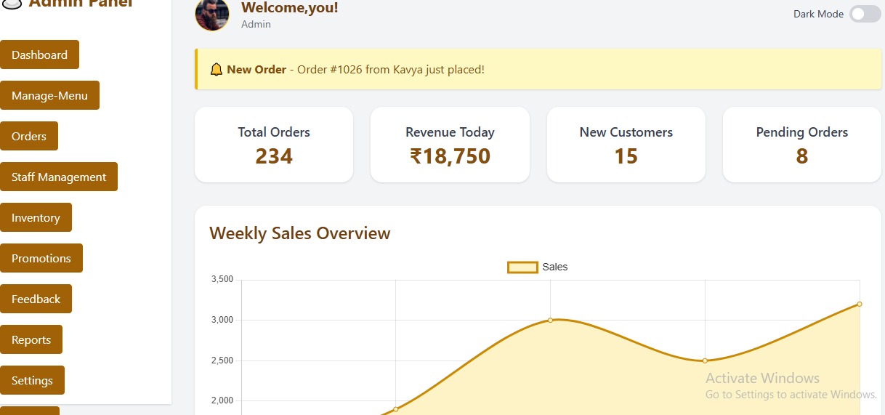
ADMIN DASHBOARD

Slide 14
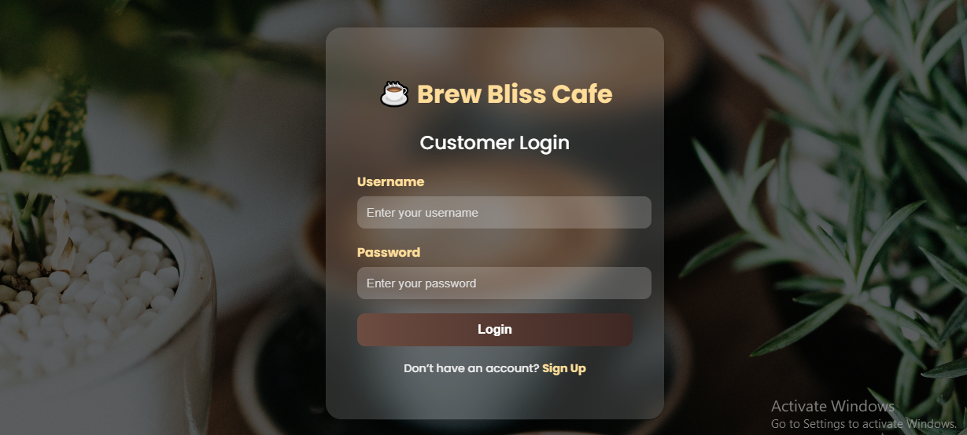
CUSTOMER LOGIN

Slide 15
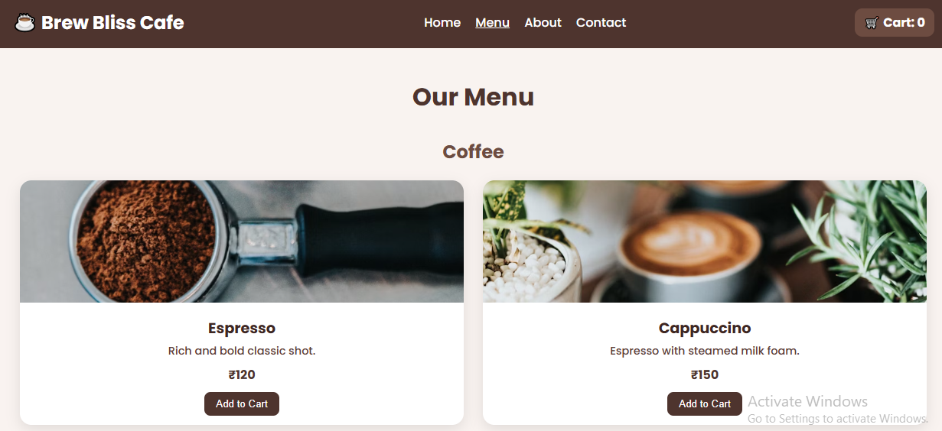
CUSTOMER MENU

Slide 16
CONCLUSION The Brew Bliss Coffee Shop Website provides a modern digital solution that enhances customer convenience and streamlines administrative tasks. By offering features like online ordering, feedback management, and an intuitive admin dashboard, the system improves customer engagement, operational efficiency, and overall business growth. This project bridges the gap between traditional in-person service and digital accessibility, creating a user-friendly platform that supports both customers and administrators effectively.
16

